Slide 1

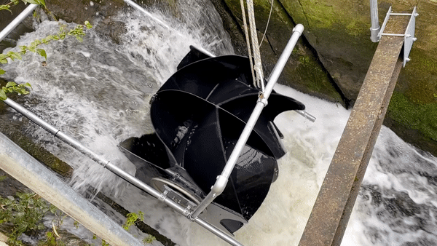
PicoStream
The Small Turbine with a BIG Future
Contact: Hydro@hallidays.com
KEY BENEFITS
Benign to fish
Up to 1kW of reliable power generation
80% + Efficiency factor
Quick and Easy to install
Affordable
Produces electricity 24 hours a day
More consistent power than solar and wind!
Suitable for Homes or Businesses
Low maintenance
Easy to transport
Very small footprint (3 square metres)
Only needs 0.5m of water drop height

Slide 2
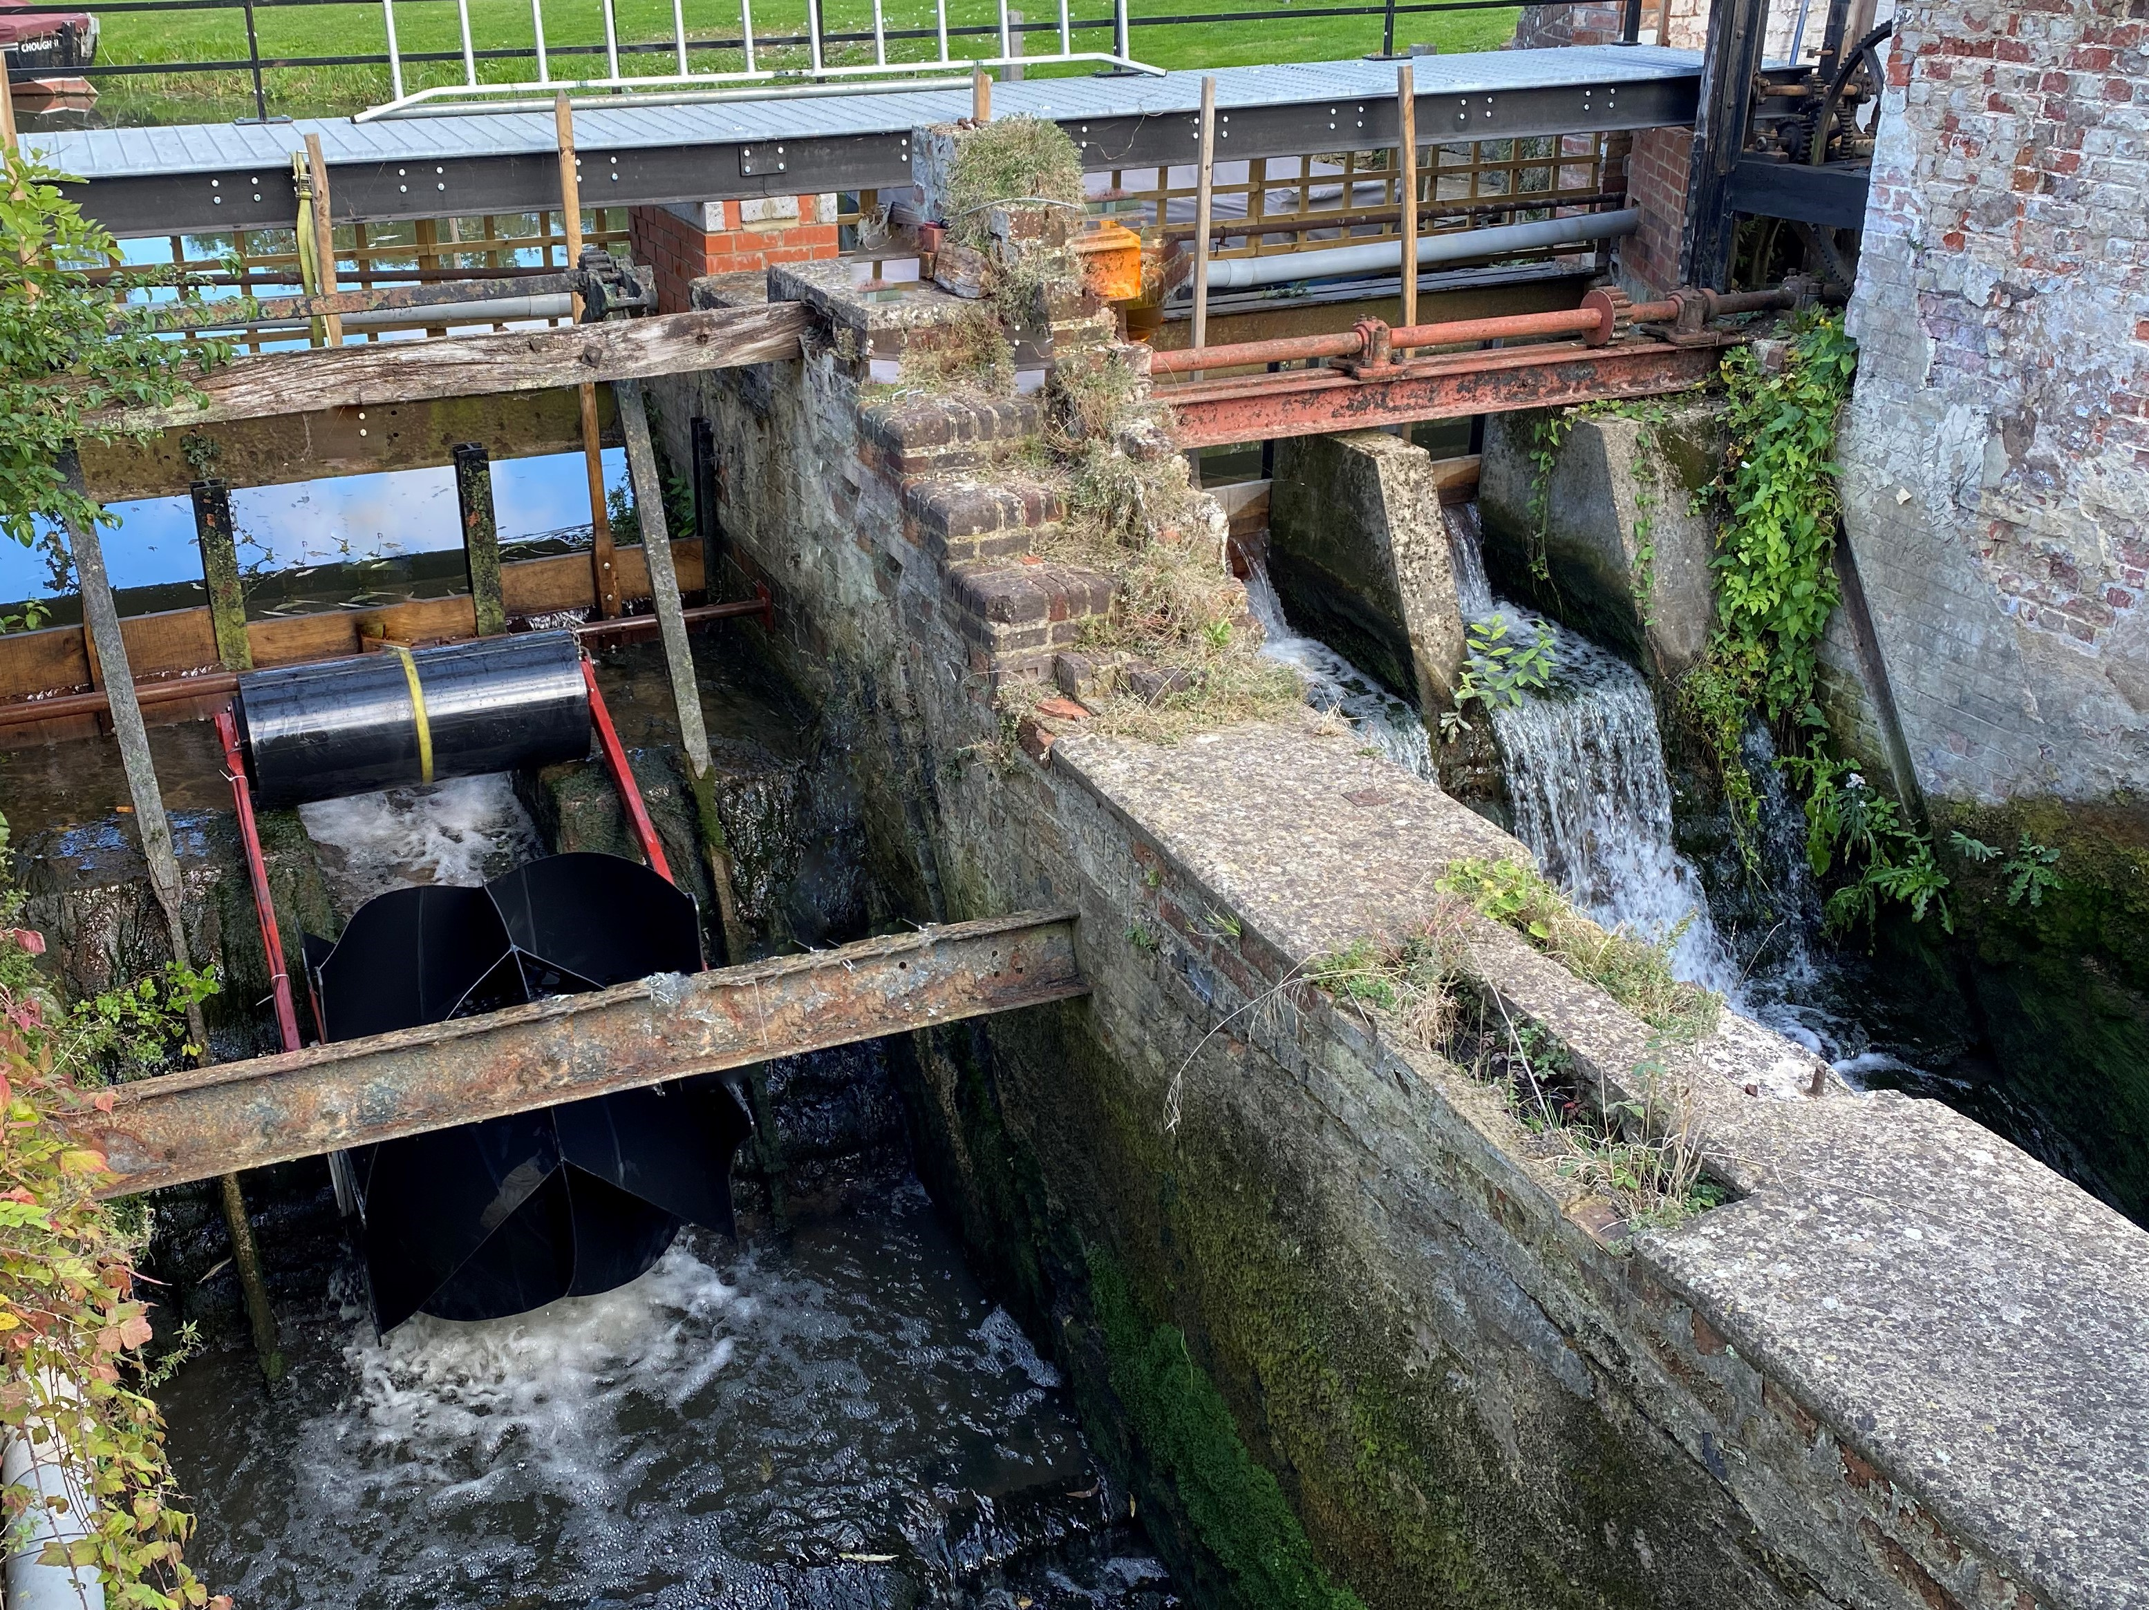
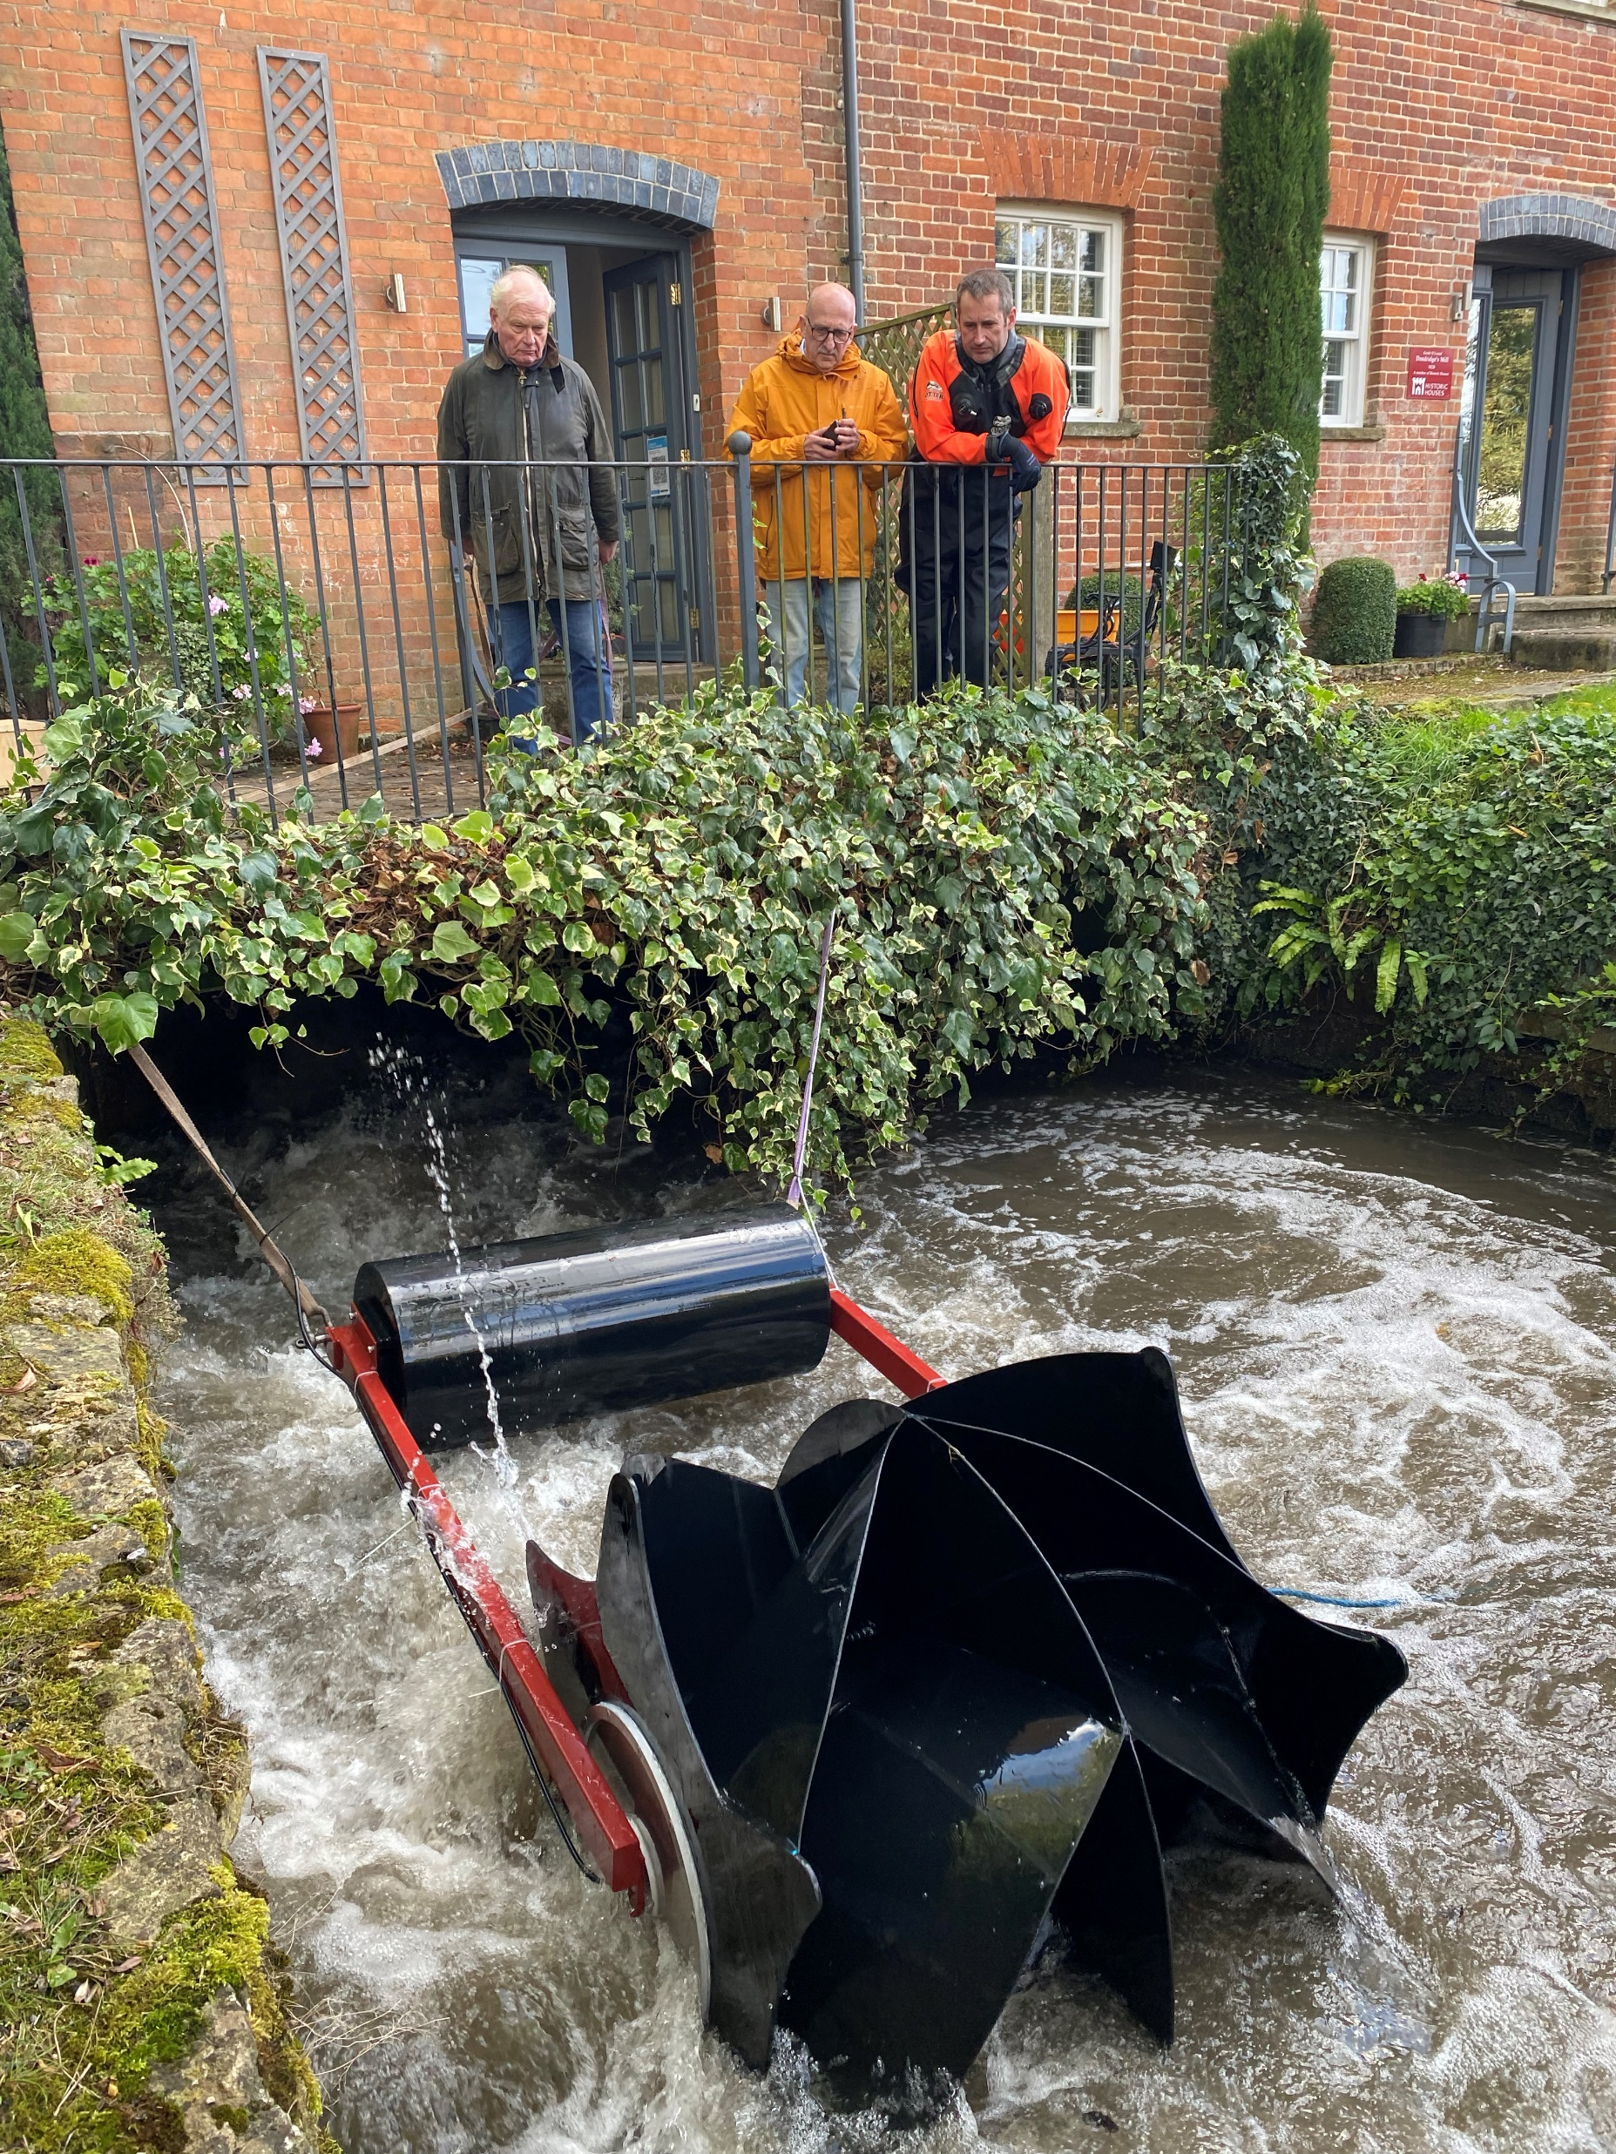
More reliable and consistent than Solar panels or Wind turbines
Weir/Sluice
Fast Water Channel
Only needs 0.5m Drop in water height (head)
Channel width 1.3 metres minimum
Suitable water flow rate
Fast flowing water (1.8m/s velocity min)
Zero drop in water required
Turbine floats on water
Channel depth 0.6m minimum
Channel width 1.3 metres minimum
Suitable mounting/attachment point(s)

Slide 3
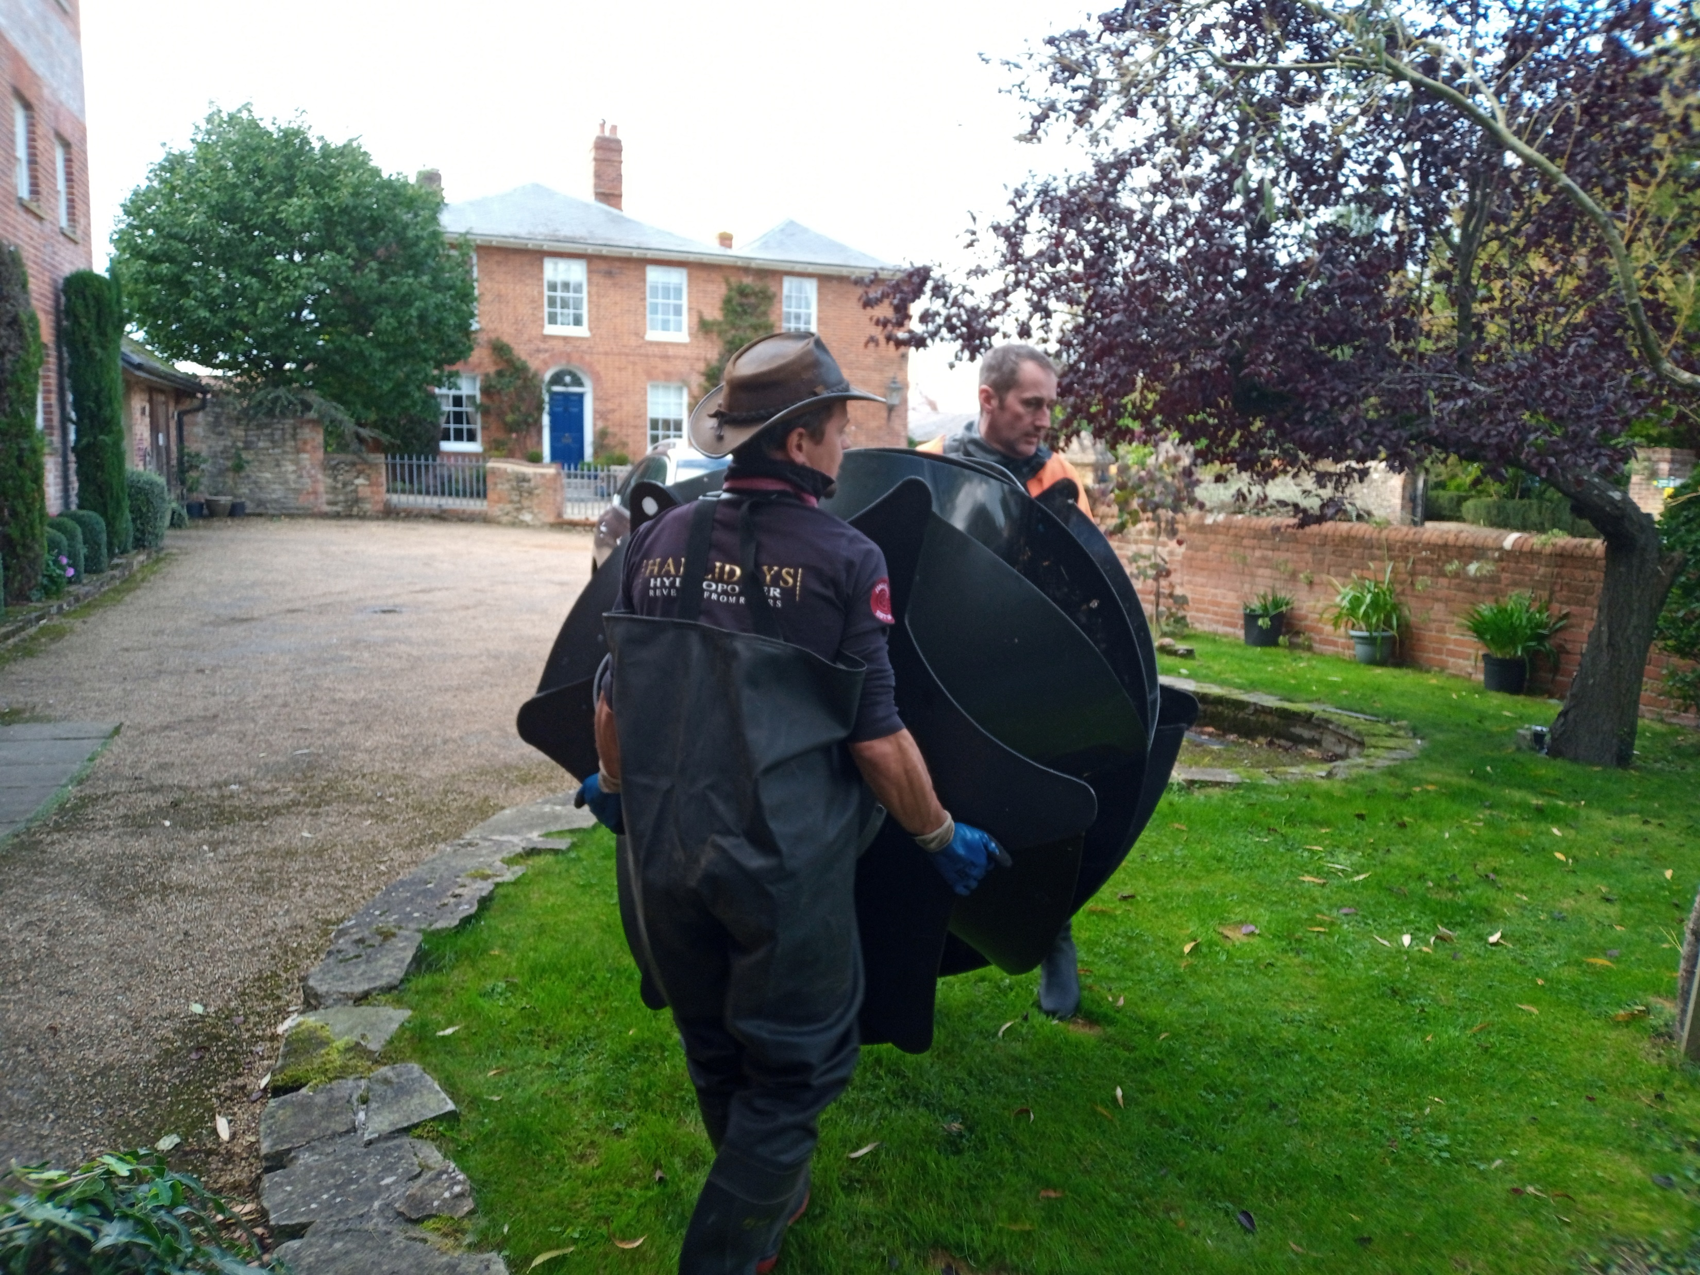
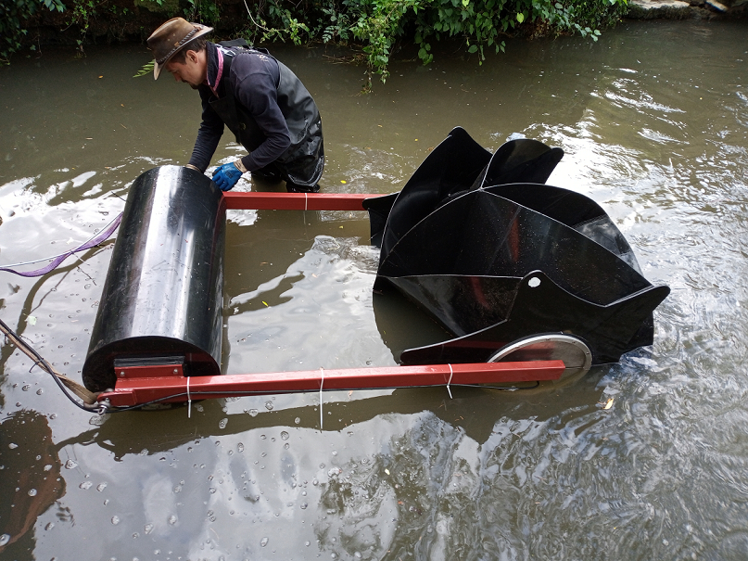
Economic & Environmental Benefits
Friendly to Fish
Does not require any major construction works
No major Environment Agency Licensing required
Easy to transport and install
Fits into existing water channels (weirs/sluices)
Produces electricity during day and night
Can charge a battery bank for off-grid power
Fantastic ‘peace of mind’ back-up generator in bad weather
Very small physical footprint – Only 3.25sqm or less
Can charge Electric vehicles
Can significantly reduce your winter electricity usage
Adds value to your property
Superior financial returns than a 5kW solar array!
Can replace a small diesel generator
Hit your Net Zero Carbon targets & reduce your carbon footprint
Great ethical investment

Slide 4
A small 600 Watt PicoStream Turbine produces MORE electricity than a 5kW Solar Panel Array Or a 2kW Wind turbine!
Fantastic Efficiency
System Power | 600 Watts | 5kW | 2kW
Efficiency Factor | 85% | 10% | 25%
Annual System Power Output (kWh) | 4,468 | 4,380 | 4,380
Daily System Output (kWh) | 12.2 | 12 | 12
Physical Space Required (sq metres) | 3 | 32+ | 20+
PicoStream
Solar
Wind

