Slide 1



Gods Gift Uganda
Bidi Bidi/Ican community
His Kingdom Blueprint
Colin - Mo.26.Jan.2026

Slide 2
Gods Gift
The Community
TEAM = Together everybody achieves more.
Every human has their role and talents and if every member of the community works together,
then every body has a Job to do.
The landowners and the people who now own animals count as Investers. And invest what they own in to the community. As all animals and Land in the beginning go to the community and longterm once Investers get their Investments back everything belongs to the community.
Colin - Wed
.11.Feb.2026

Slide 3
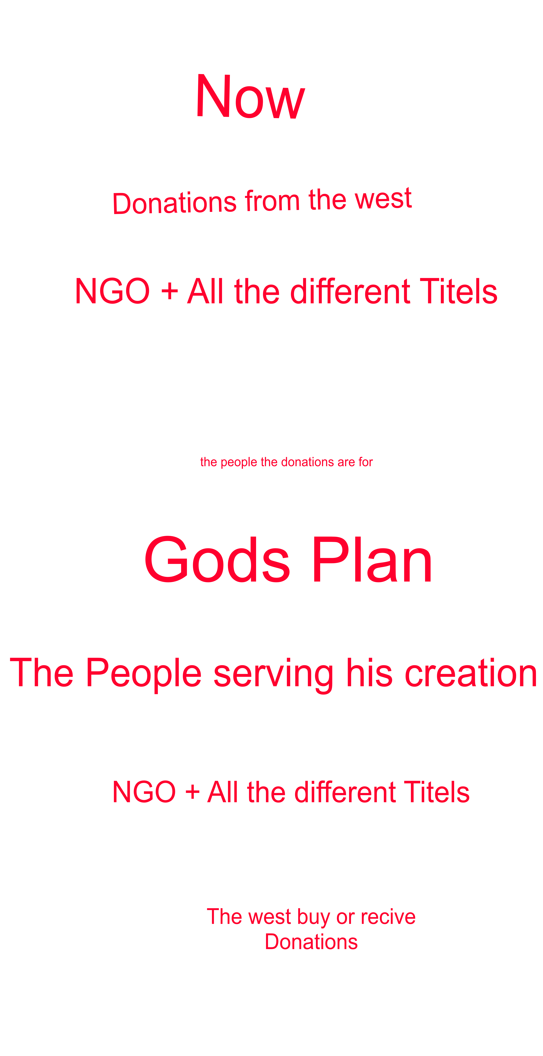
Gods Gift
Present situation
Donors give money to the Titles for the People.
The Titles answer and work only to please the Donors
While costing much of what is Donated. Because costs are rising
and income is decreasing.
The people that the Donations are for are receiving less and are
  becoming increasingly hungry and frustrated.
Colin - Wed
.11.Feb.2026

Slide 4
Gods Gift
How God would like it.
All funds are invested in creating Farms and Gardens
That are for the people to work and serve
The Titles use their skills to coordinate and sell all the products
for the people.
The Donors become customers or if war breaks out receive Donations.
Colin - Wed
.11.Feb.2026

Slide 5
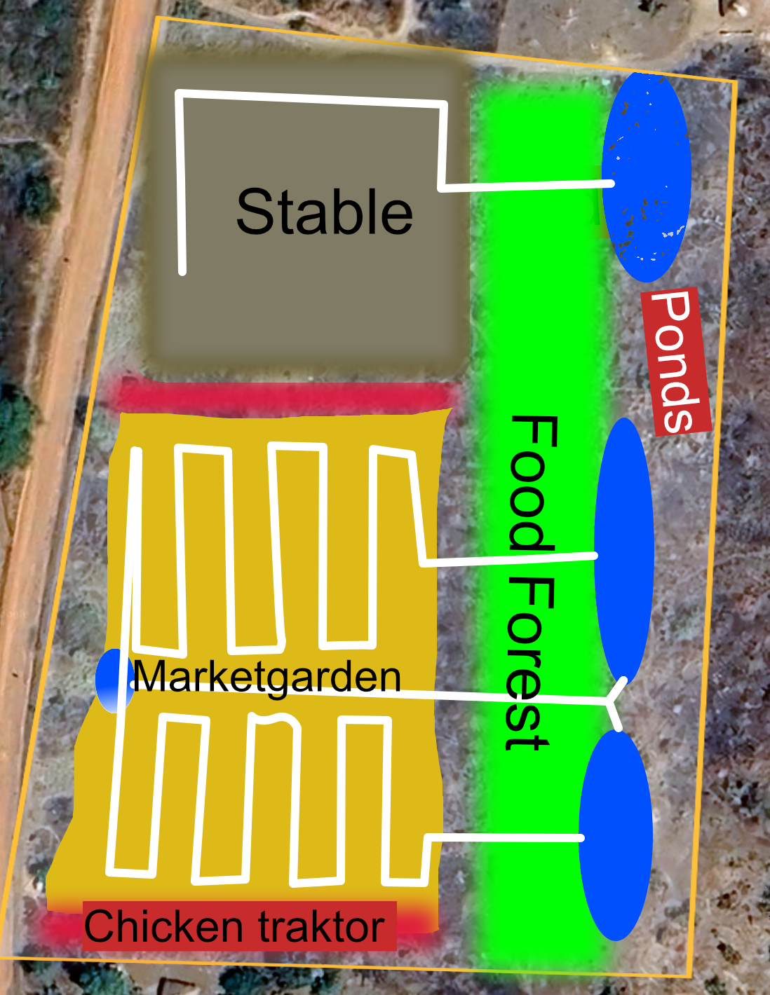
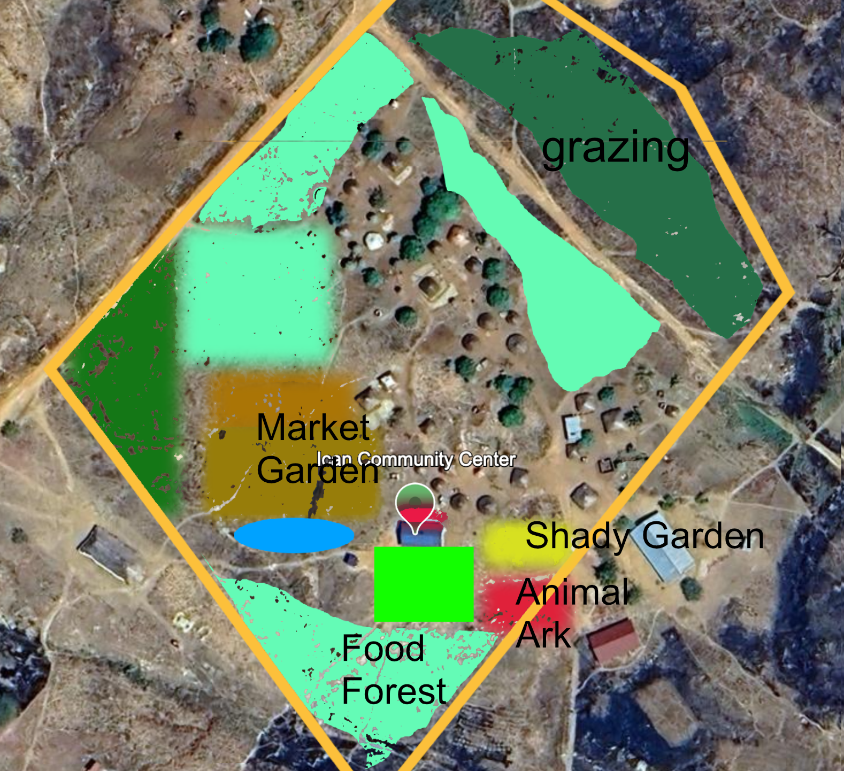
Gods Gift the 3 types of Farm
Every Sector has
The Ranch is the Main Center of the Farms here the Male Animal are kept for Breeding and and Mast, the Ranch needs plenty of Grazing Land.
Is situated right next to the Market the Community Market sellers are the ones who grow their products there There is also a Stable for live stock selling and a Butcher/ Slaughter House for the selling of Meat
Each homestead farm should ideally feed 4 Families and produce abundantly enough so a 3rd can be sold to Market to create Income for the Homestead.
All farms consist of Food Forests, Animal Arks, Veg-, Shady Garden, Pond and Grazing Area.
1 Ranch
1 Market Farm
Many Homestead Farms
Colin - Wed
.11.Feb.2026

Slide 6
Gods Gift 1/3 Principle
All Products
1/3 Goes to the community to feed everyone (Community always first)
1/3 Gets sold to Local at Market Hotels/Restaurants and Shops,
Long term the communities own channels.
1/3 Return for production (Animal feed, Compost, Multiply
Fruit
Vegetables
Animals
Building Material
Colin - Wed
.11.Feb.2026

Slide 7
Gods Gift 1/3 Principle
Turnover & Profit
Costs are first taken out of Turnover/ Income,
1/3 Goes to Investor until the Investment is paid back. Then the community becomes the Investor.
1/3 Goes to pay the costs for the community, plus an Income for each member.
1/3 Is invested in Growth of Community, Buildings, Roads, Schools Hospitals.
Colin - Wed
.11.Feb.2026

Slide 8
Gods Gift
Fruit & Vegetables
Fruits - Are easy work and grow by them selfs once planted (perennial)
Just need harvesting and processing (depending on goal/
More you have more is possible)
Vegetables - A lot more work as the processing starts over every Season (Annual)
Besides Labor both need Water and Compost. Processing and Transport for Selling.
Colin - Wed
.11.Feb.2026

Slide 9
Gods Gift
Animals
The more the better and as many different ones as possible. (Diversity)
Most Important product is their Manure. For Compost that give fertility.
To Improve soil health and save on Feed costs we rotational graze all the animals.
Chickens are used in Mass compost production (Chicken Tractor on Steroids)
The food products from all animals are Eggs, Dairy and Meat. Extra products gained are
Skins for Leather and Clothing.
We also breed the strong and healthy for Live stock multiplication and selling.
Colin - Wed
.11.Feb.2026

Slide 10
Gods Gift
Building Materials
Trees are needed for shade and effective farming and any tree,
that is not used for food, can been seen as Building Material.
Soil building - Mulch, Compost, Paths, Animal floors - Wood chips (Soft Wood)
Housing, Fencing, Furniture ( Hard Wood)
Charcoal for cooking (Left overs)
Stones & Clay for Buildings and Water works.
Colin - Wed
.11.Feb.2026

Slide 11
Gods Gift
School
&
Tourismus
Besides being a school for the children, the school can also be used to teach
Farmers and community leaders from where ever they want to come from.
Once the Community is running successfully, it can be used as a Blueprint anywhere
in the world. And who travels to Bidi Bidi to learn will need accommodation and feeding,
the same infrastructure can also be used for people who just want to come and look
and enjoy Gods Kingdom. Both the school and accommodations, restaurants
and shops then become additional work space & income for the community.
Colin - Wed
.11.Feb.2026

Slide 12
Gods Gift
Colin & Bonny
Works for God and only answers to him. He speaks Gods word and truth.
His main priority is the children and animals.
His mission is to establish and teach, Gods plan / Gods Gift in the community. For a year.
After that the community will be able to carry on by its self - efficiently if they abide by Gods plan. If they so choose.
In this year he is to be provided with food, health and accommodation (legal). And anything he needs to get the Job done. He has no right to Luxuries from the community, yet what he says is needed come with ahtourity from God, as he has to always ask God first for permission to ask the community for it,
He has the objective to spend as little as possible, and make every penny count for at least 3 pennies. Any financial profit that is made by the community, as a result, they must pay 3% to Colin as long as he is on earth. This counts as his money and is for him to decide what and how he invests it in. He is only asked to invest his time, knowledge & Energy in the community to his best intentions and for his king the Lord.
Every thing he does he is doing for God and so God is his only Judge and will Judge him and the Community fairly. And if they all abide by his plan the will prosper and be a blueprint for his Kingdom.
Colin - Wed
.11.Feb.2026

